Slide 1
Where Good Customer Service is Everything!
West Hoke Middle School
Our Theme for 2023-2024: “Daring to Deserve More: Looking for Growth at Every Opportunity”

Slide 2
VISION
To engage all students in their educational process and to provide opportunities for academic success in the 21st century in conjunction with the support of parents, educators and the community.

Slide 3
MISSION
The West Hoke Middle School Community will inspire, motivate, and educate lifelong learners in a safe, respectful, and nurturing environment.

Slide 4
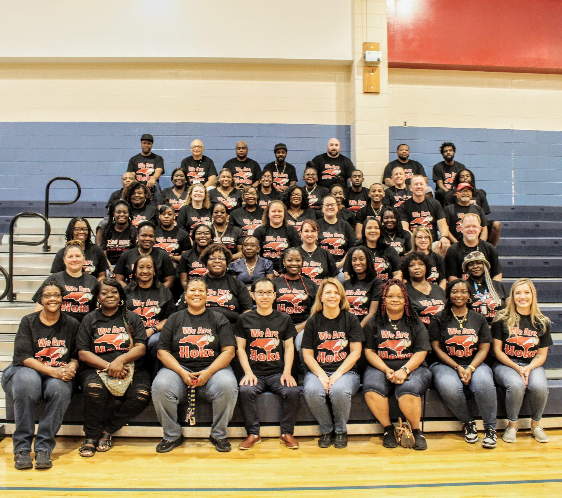
Strengths & Celebrations
“Daring to Deserve More: Looking for Growth at Every Opportunity”
The “West Hoke” Way
Performance Grade: C
Exceeded Growth

Slide 5
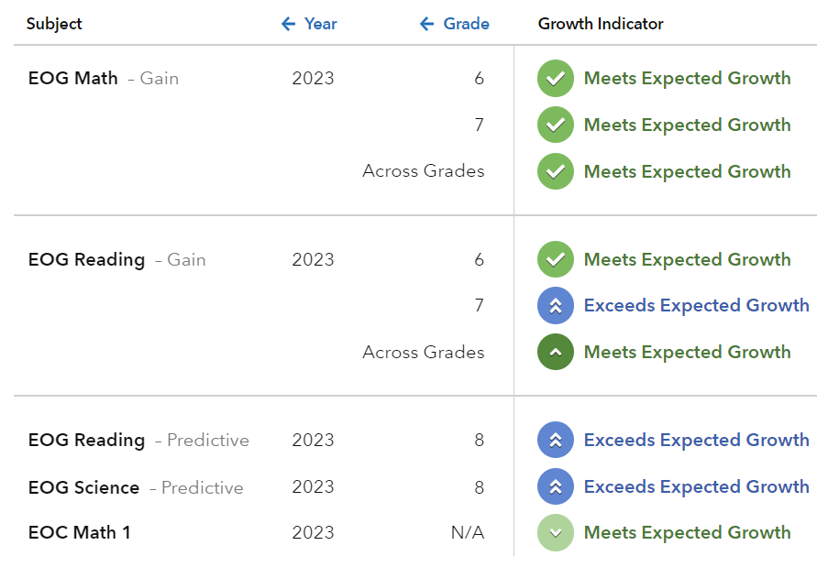
EVAAS DATA

Slide 6
SCHOOL PERFORMANCE GRADE: C
CCR
GLP
GROWTH
2022: 24.0
2023: 24.5
2022: 40.7
2023: 48.2
2022: Met Growth
2023: Exceeded Growth

Slide 7
READING
6TH
7TH
8TH
2022:
GLP: 29.1
2023:
GLP: 36.7 (7.6)
2022:
GLP: 37.9
2023:
GLP: 46.1 (8.2)
2022:
GLP: 40.4
2023:
GLP: 52.5 (12.1)

Slide 8
MATH
6TH
7TH
8TH
2022:
CCR: 17.4
GLP: 36.6
2023:
CCR: 20.0
GLP: 42.4 (5.8)
2022:
CCR: 24.0
GLP: 35.9
2023:
CCR: 26.9
GLP: 43.1 (7.2)
2022:
CCR: 11.1
GLP: 28.5
2023:
CCR: 10.0
GLP: 43.9 (15.4)

Slide 9
SCIENCE
2022:
CCR: 63.1
GLP: 72.3
2023:
CCR: 64.3
GLP: 75.3

Slide 10
WHAT IS TITLE I?
According to the US Government’s Department of Education, Title I “provides financial assistance to local educational agencies (LEAs) and schools with high numbers or high percentages of children from low-income families to help ensure that all children meet challenging state academic standards.”
West Hoke Middle School is a Title I school.
Title 1 Video

Slide 11
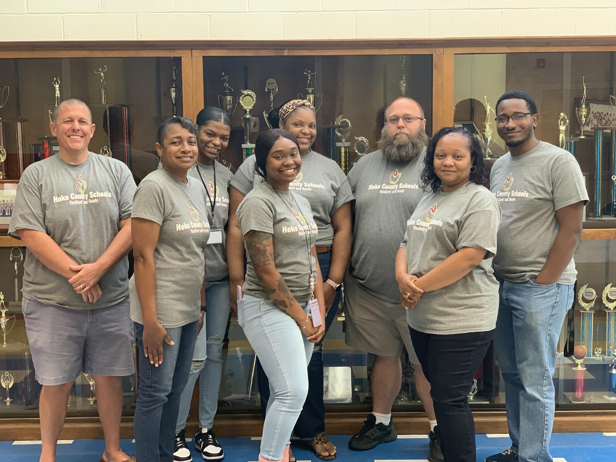
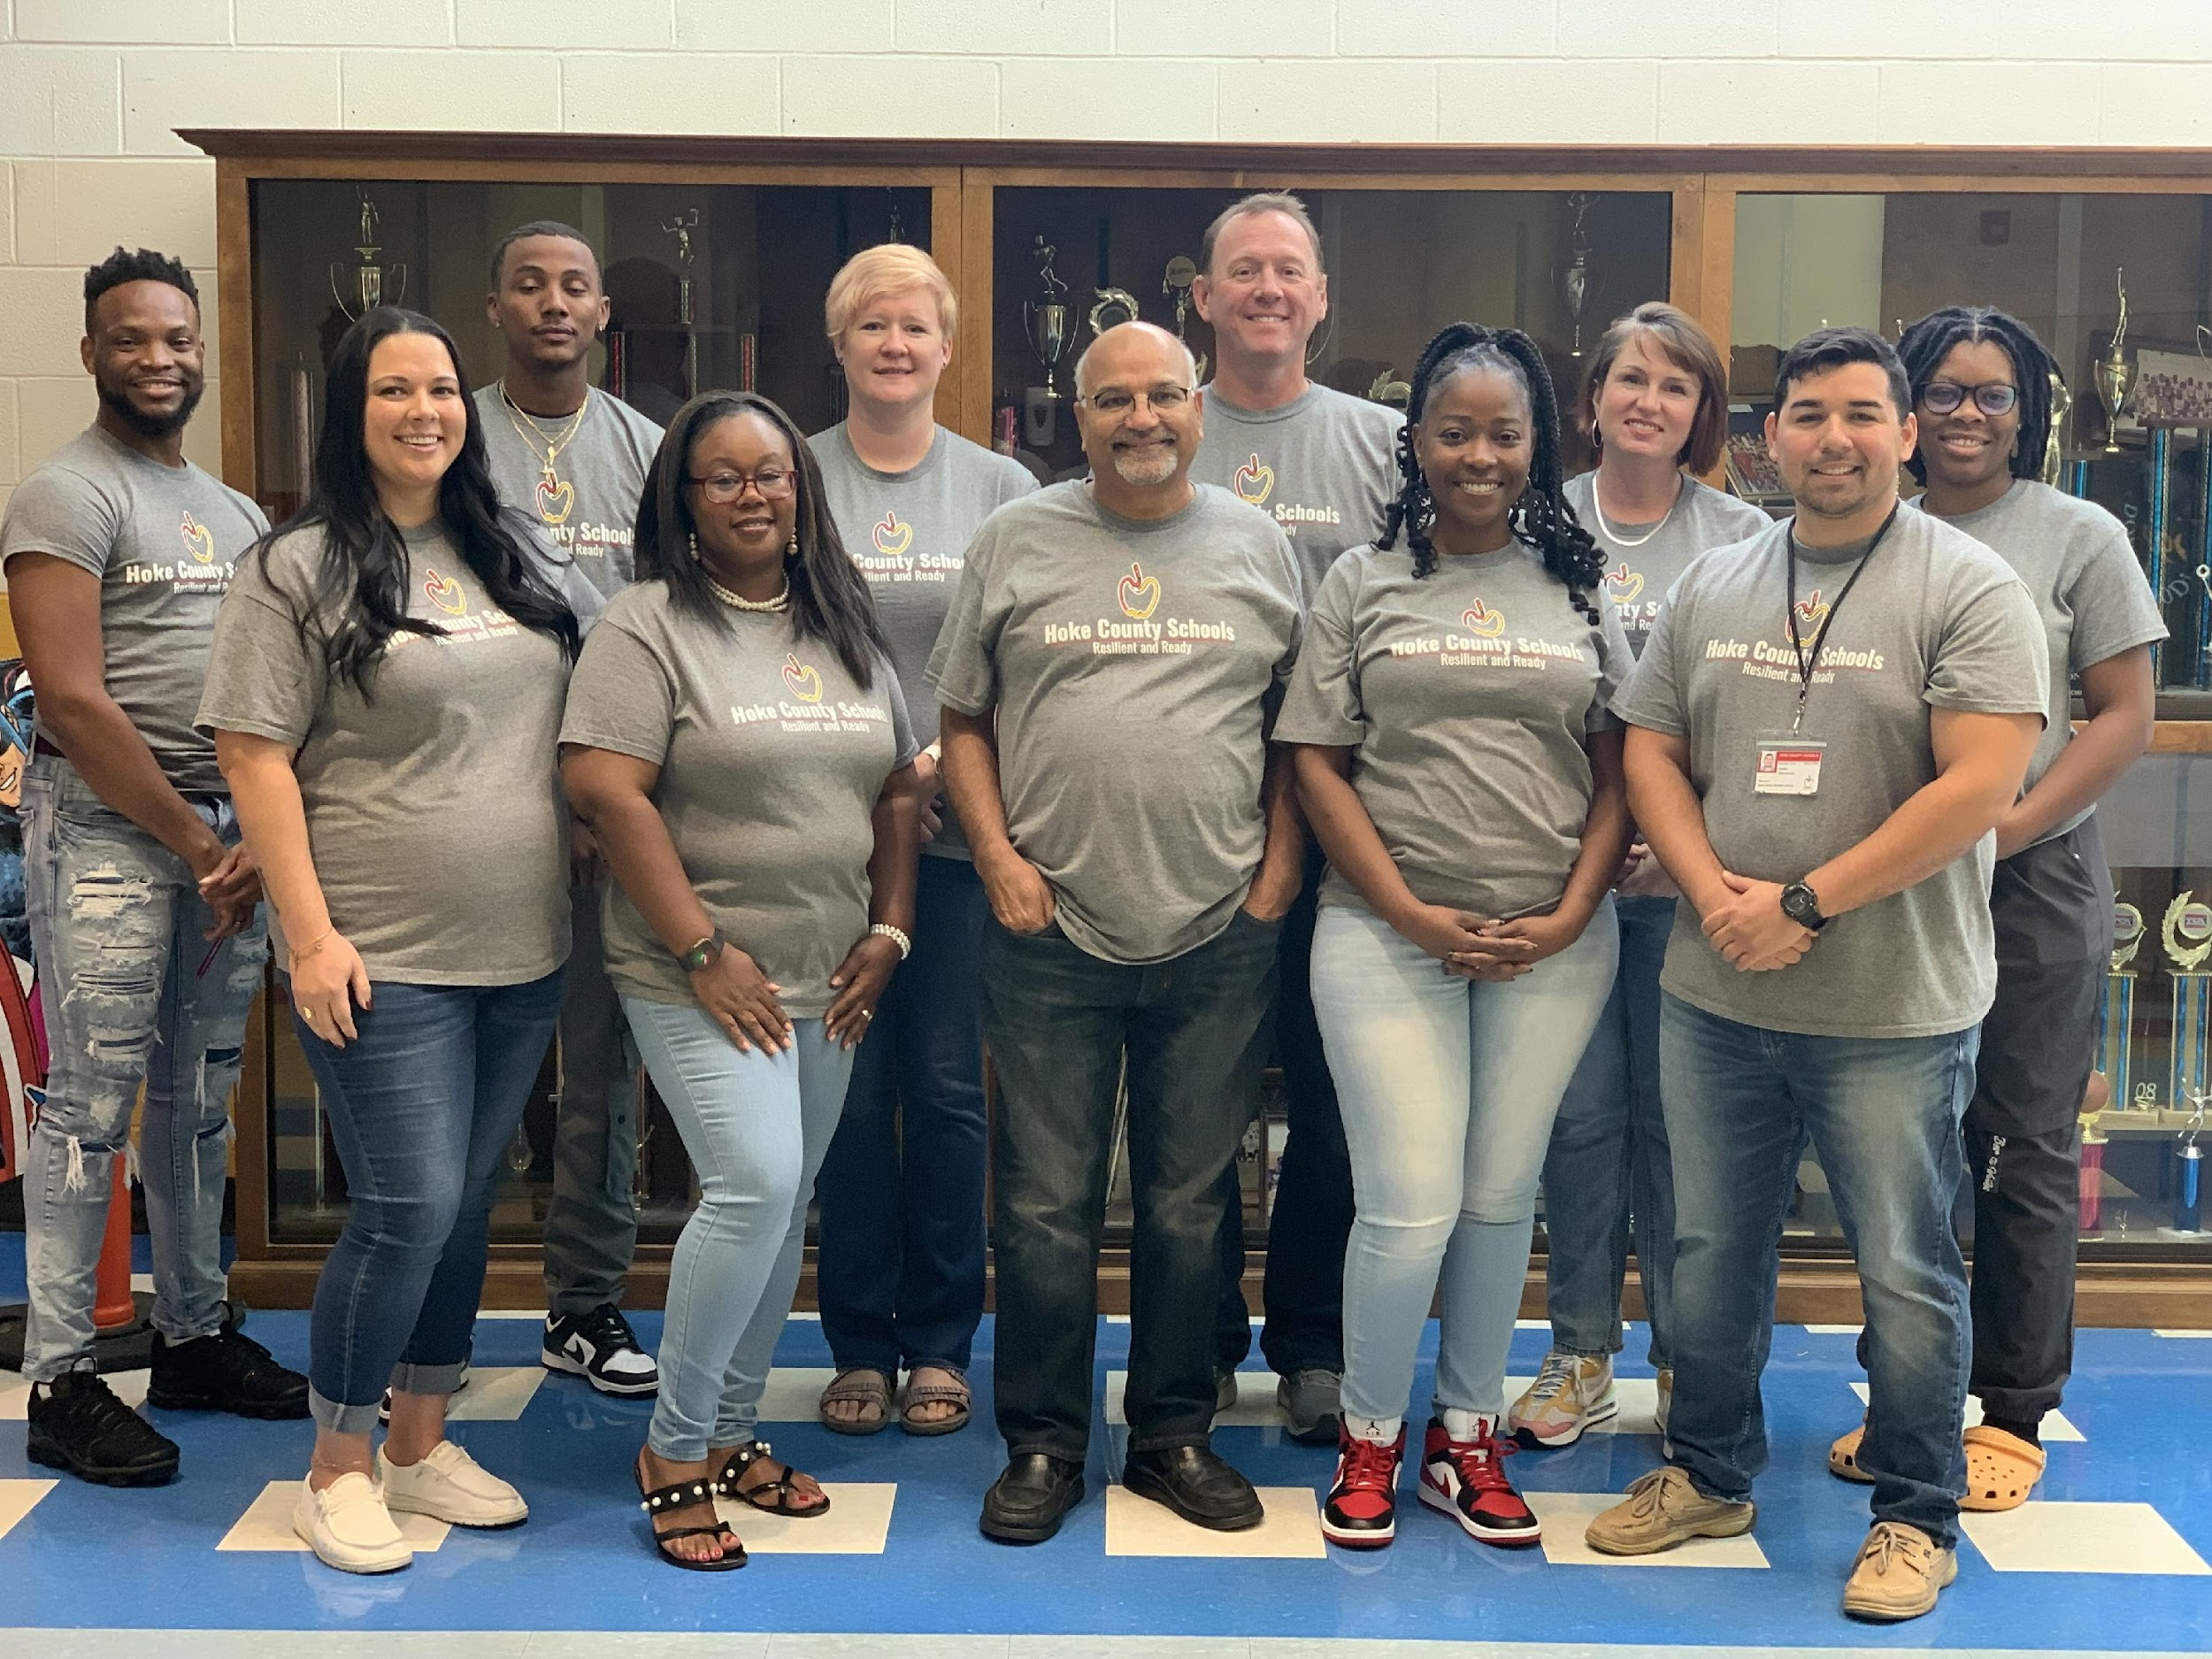
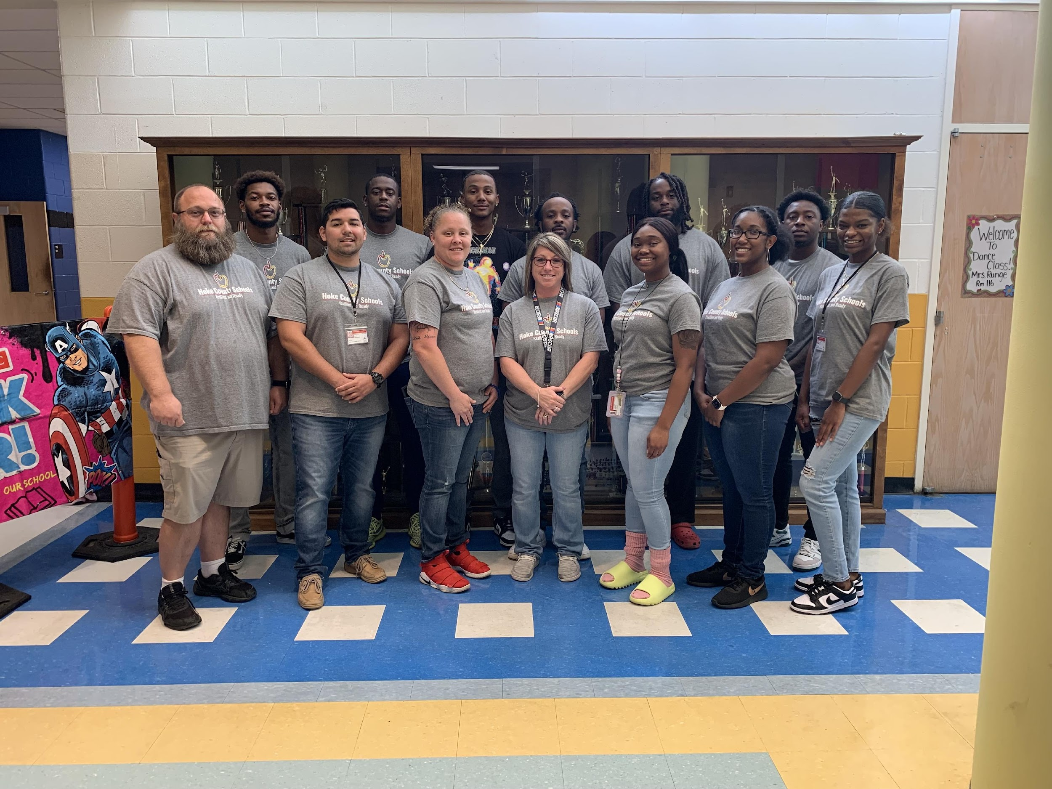
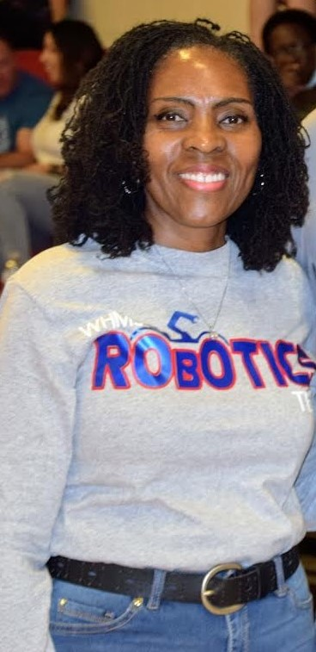
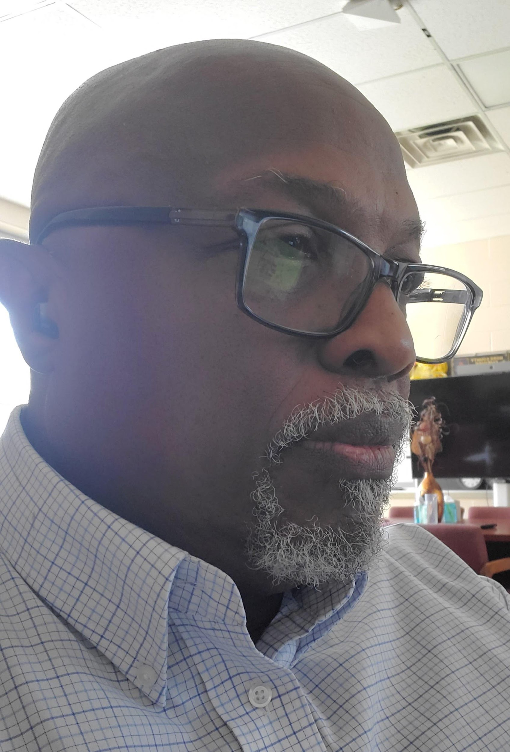
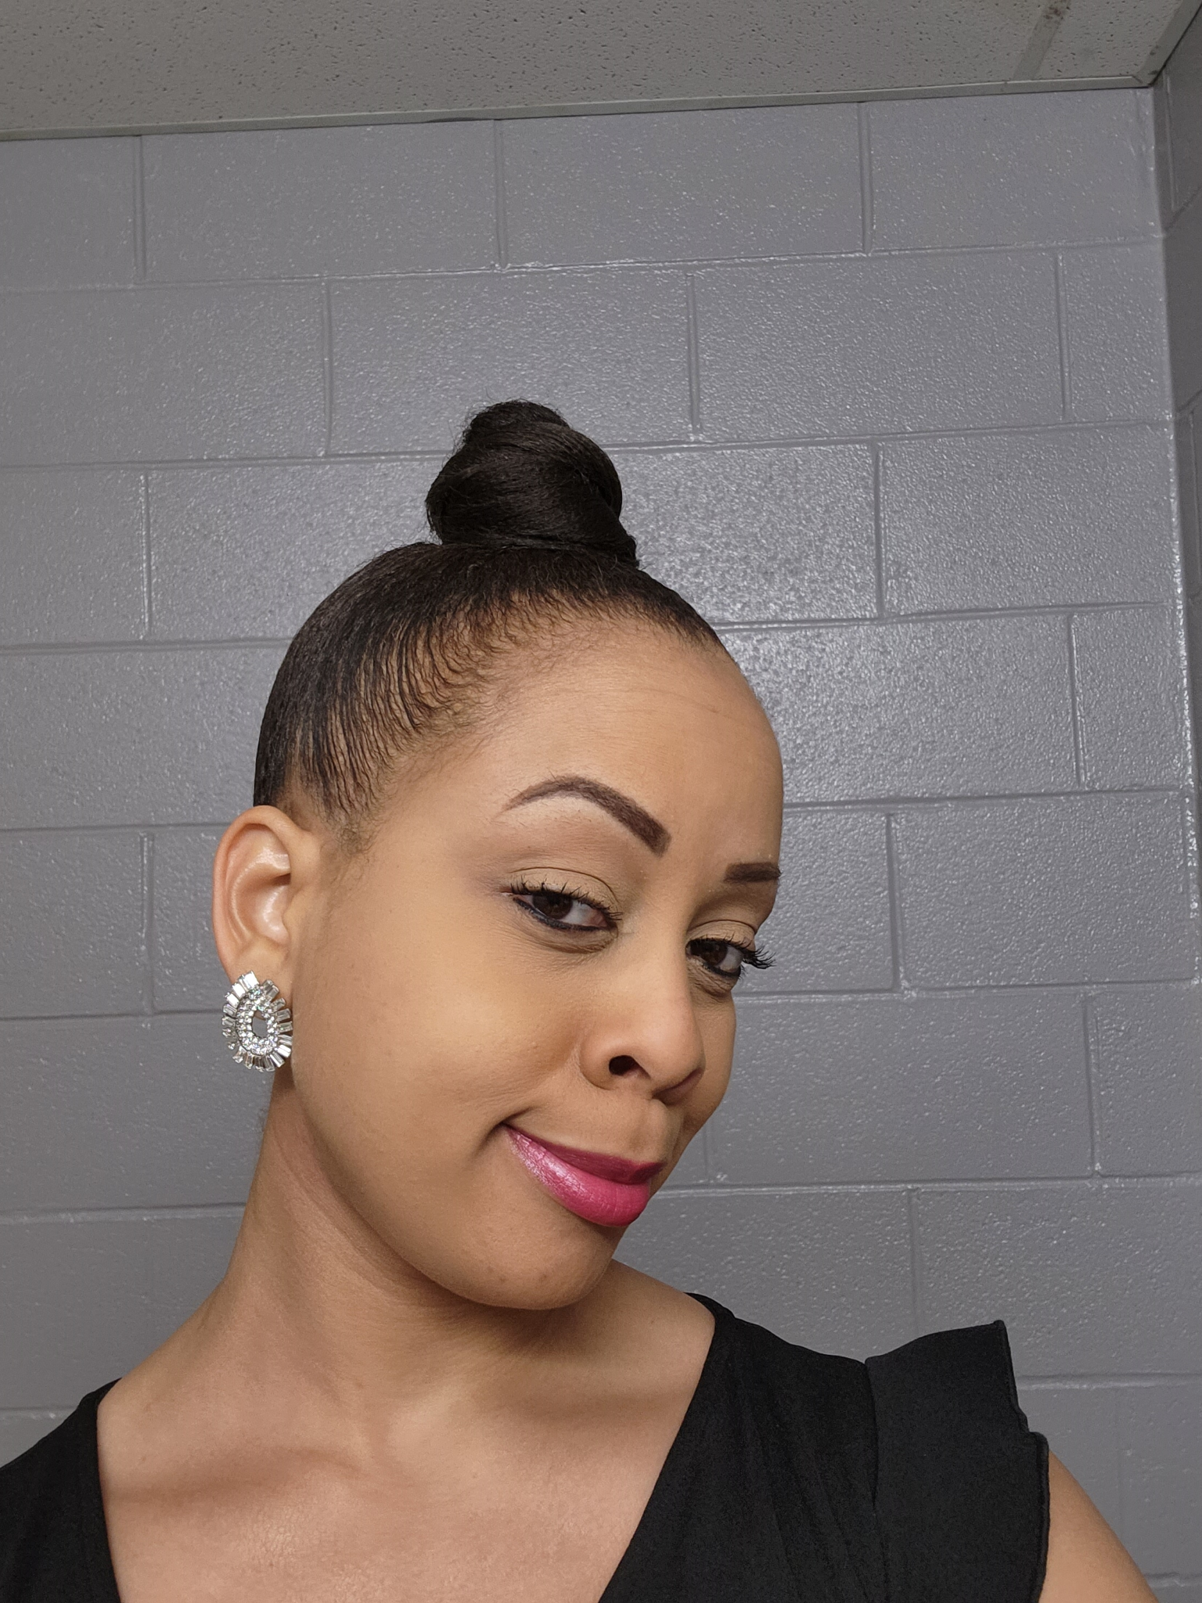
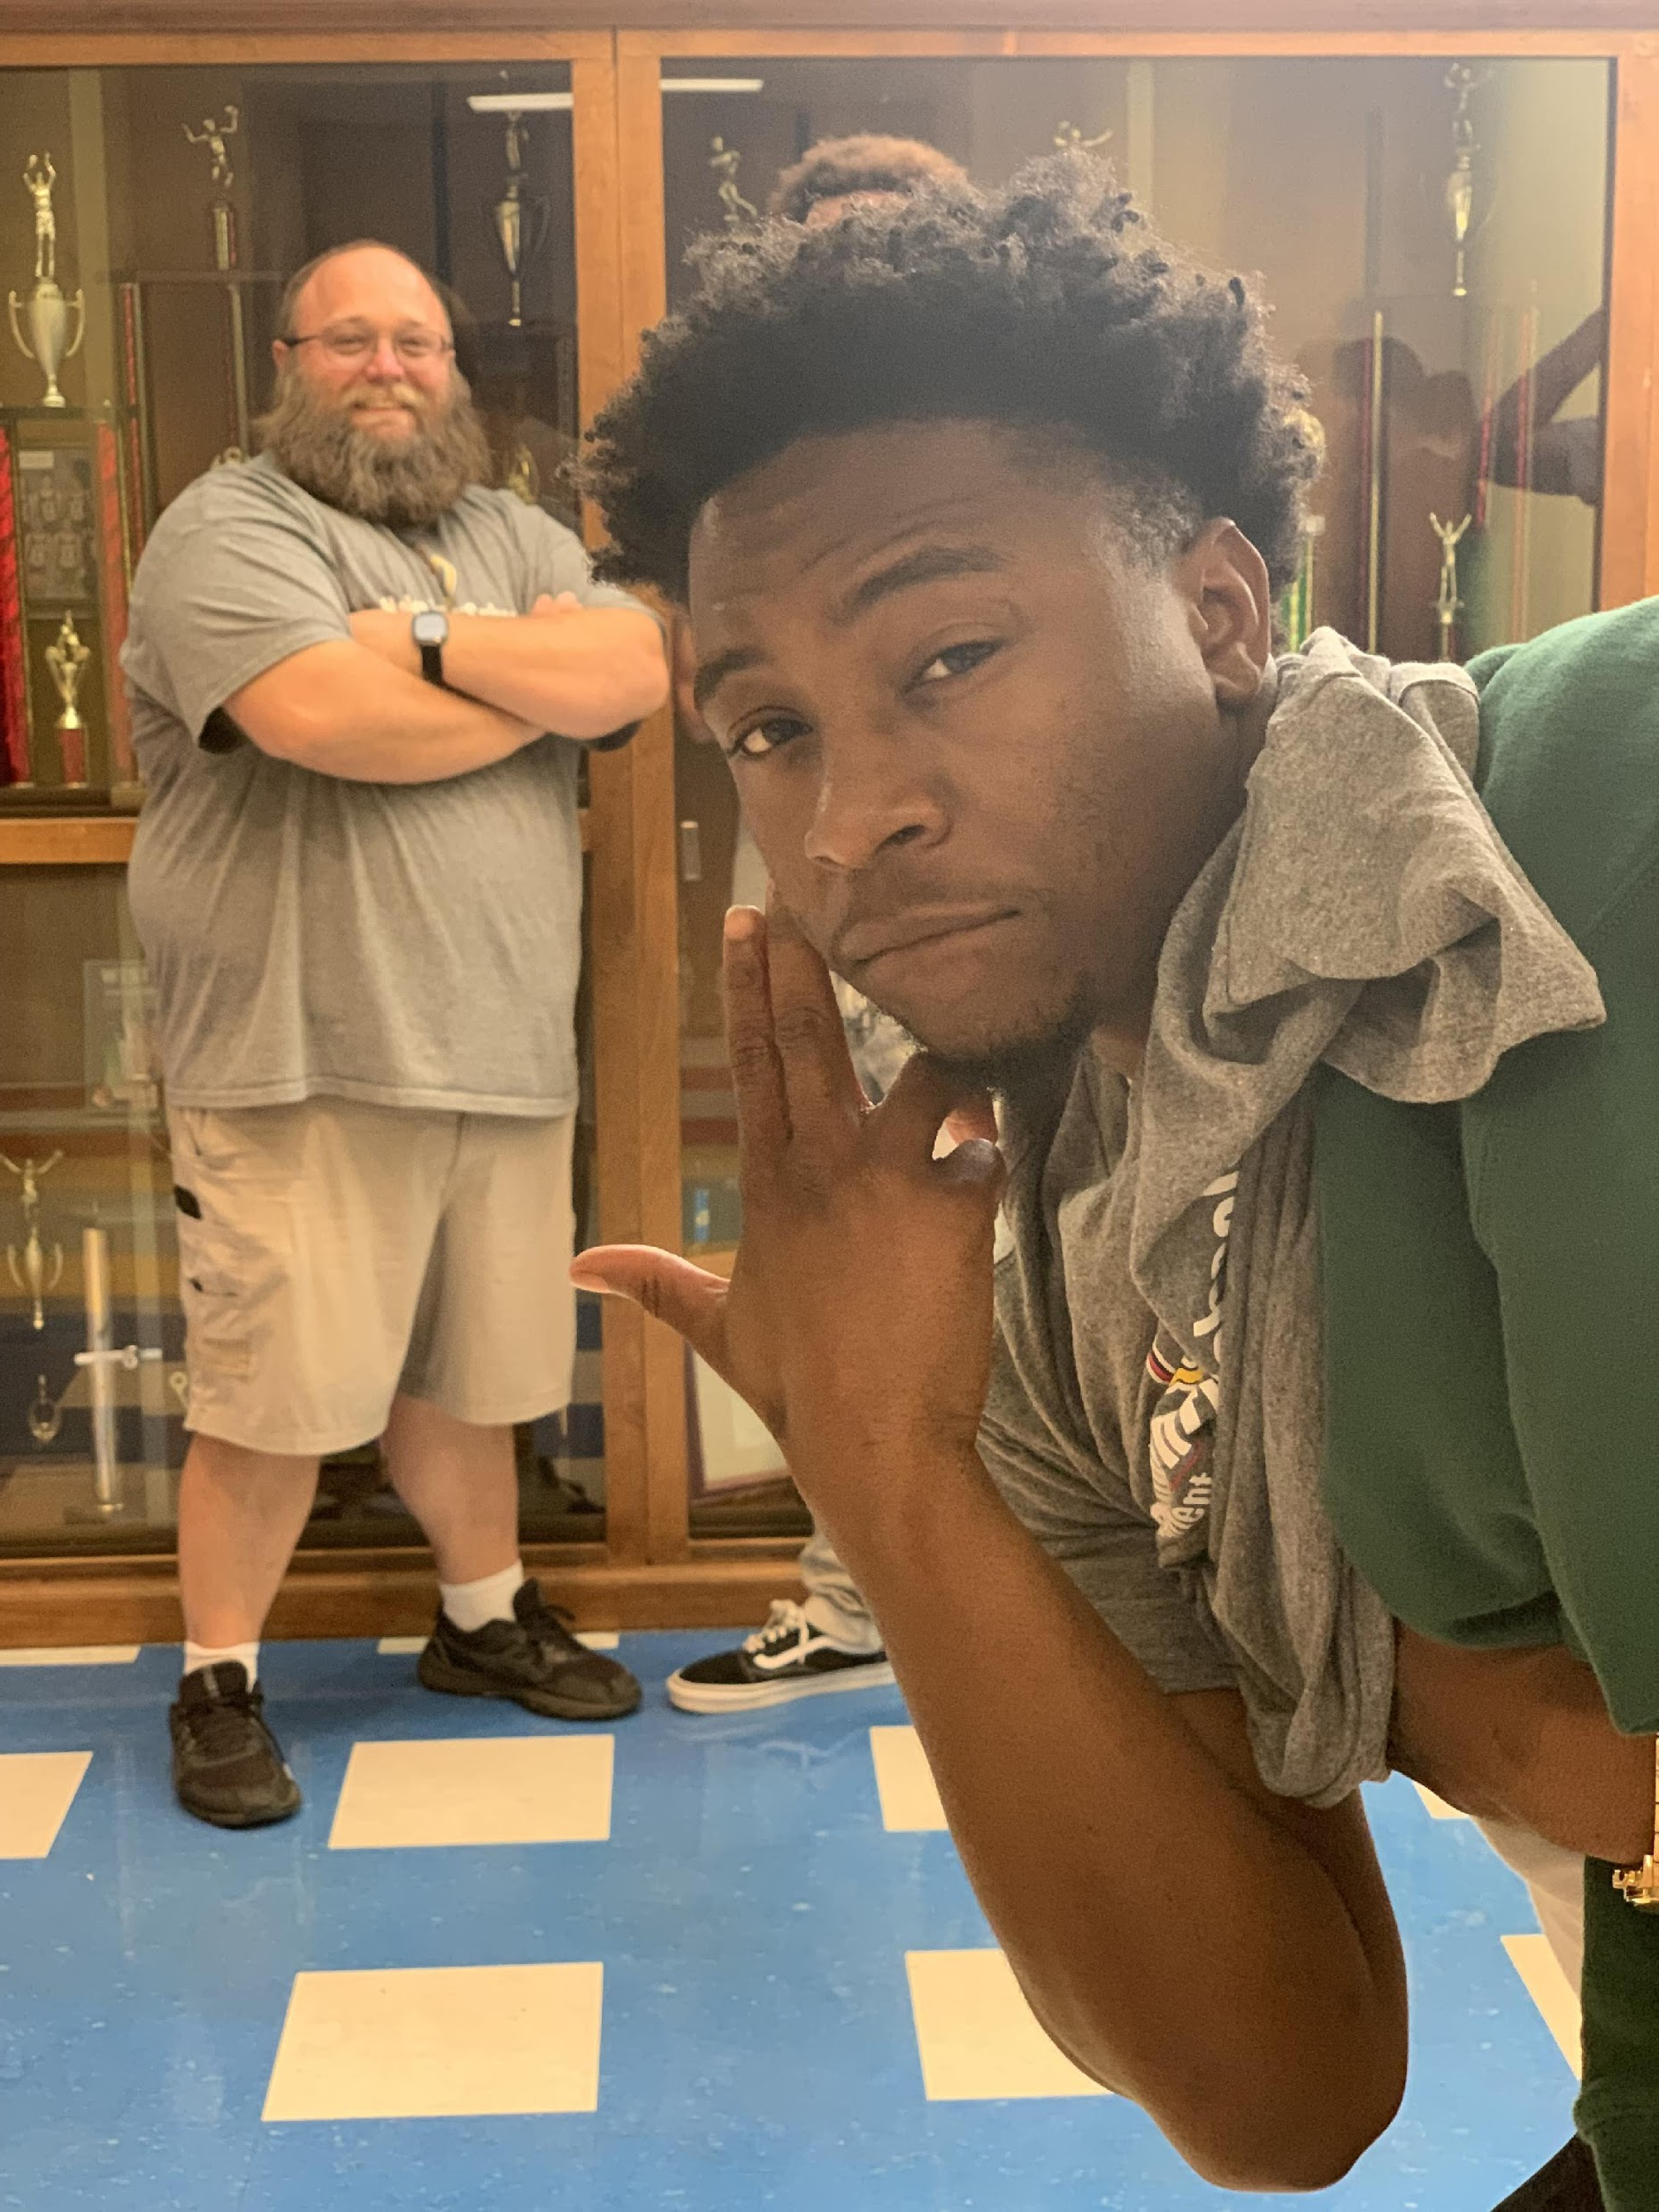
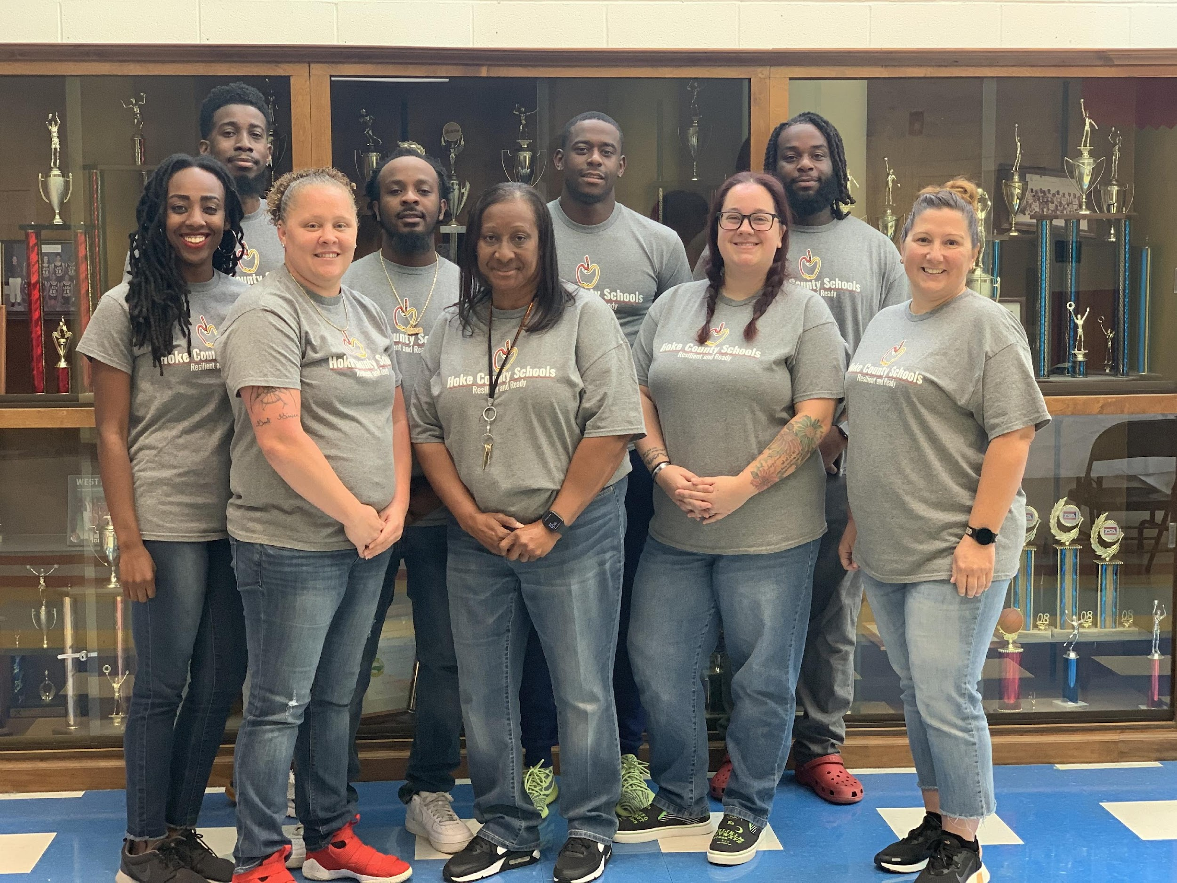
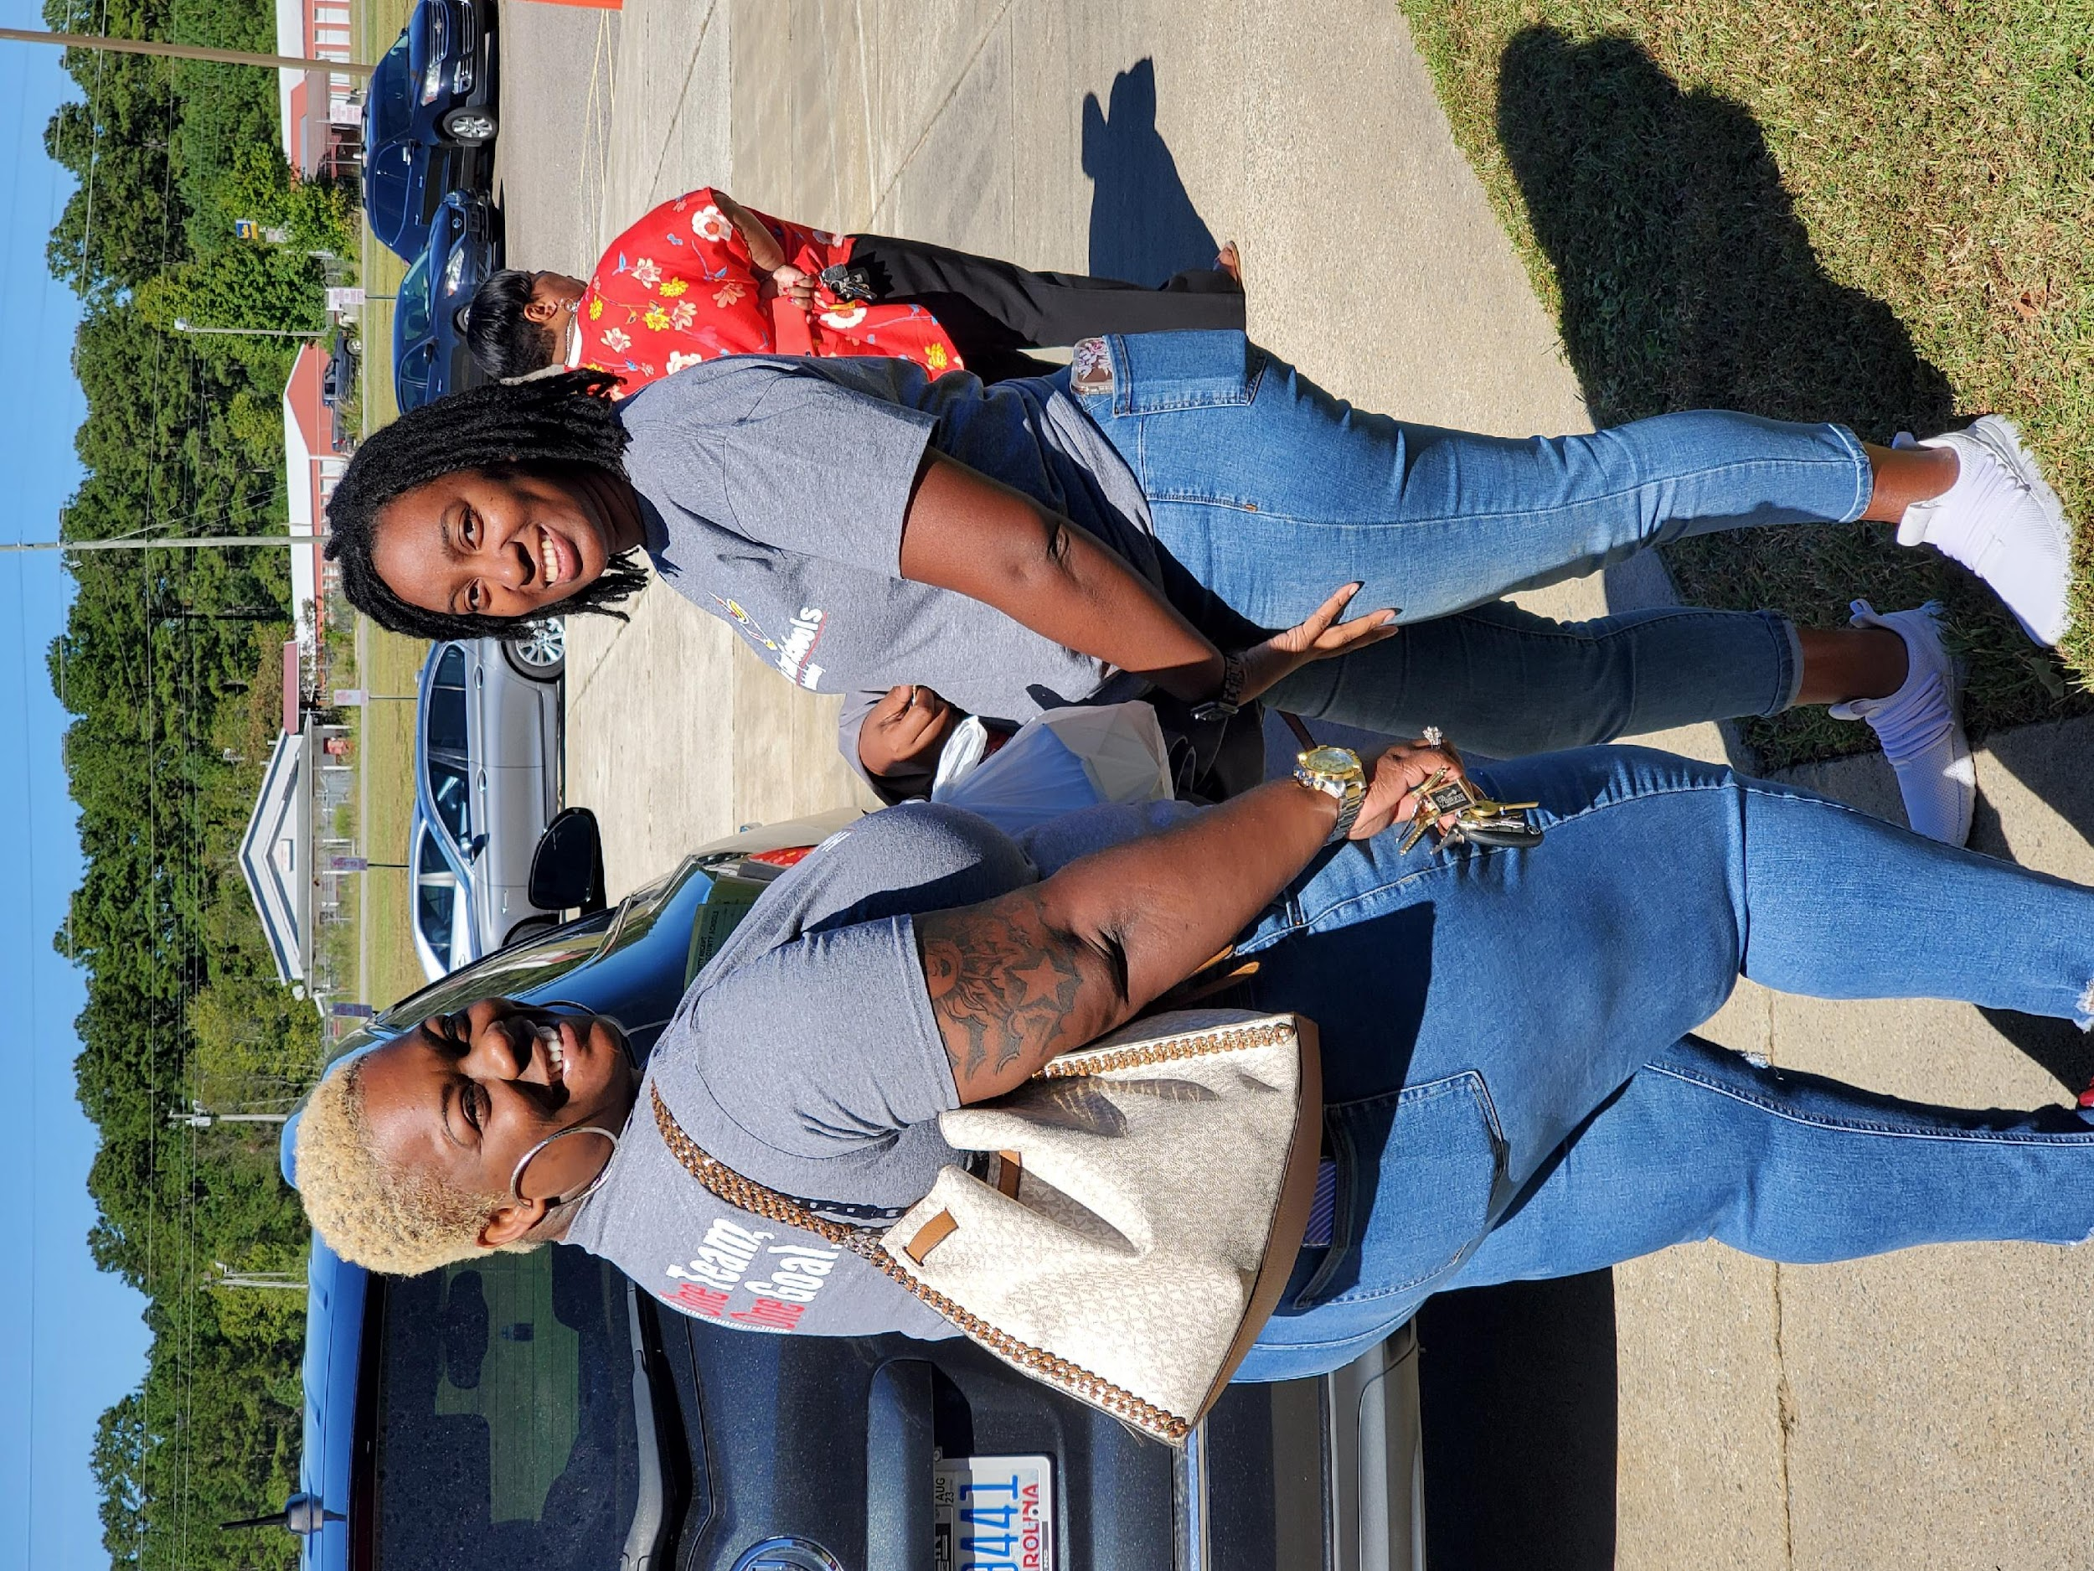
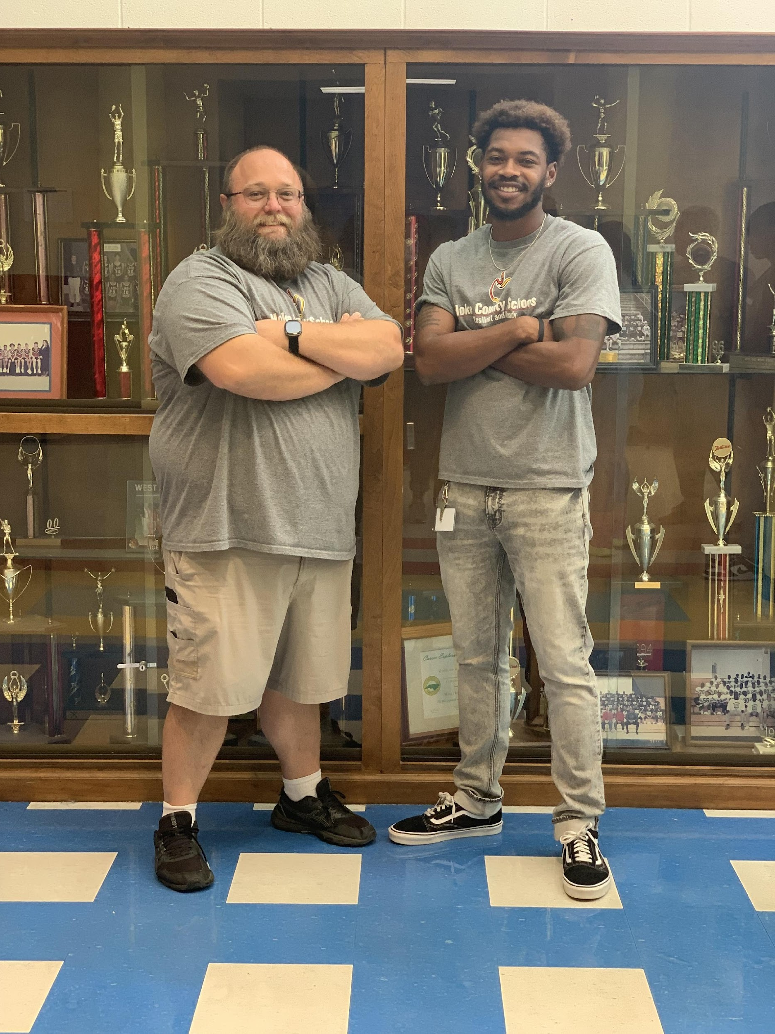
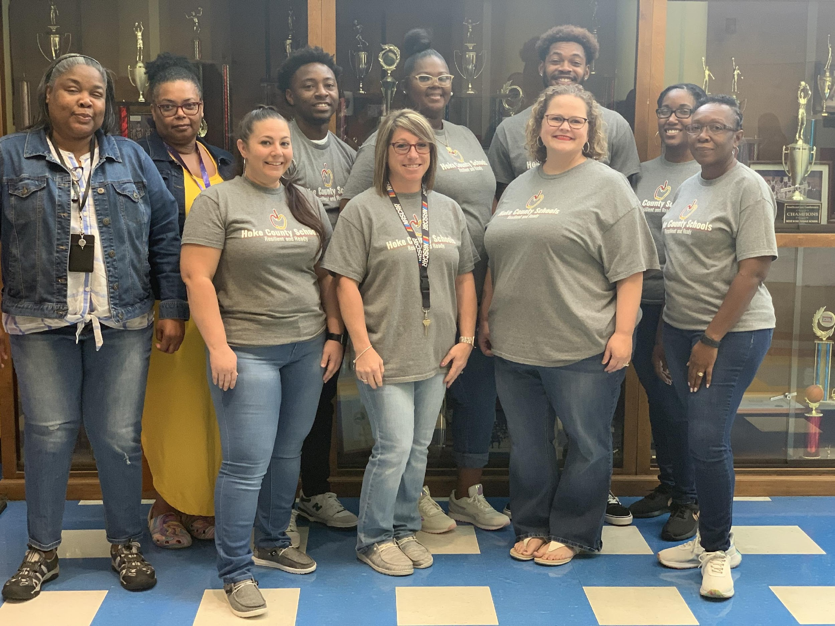
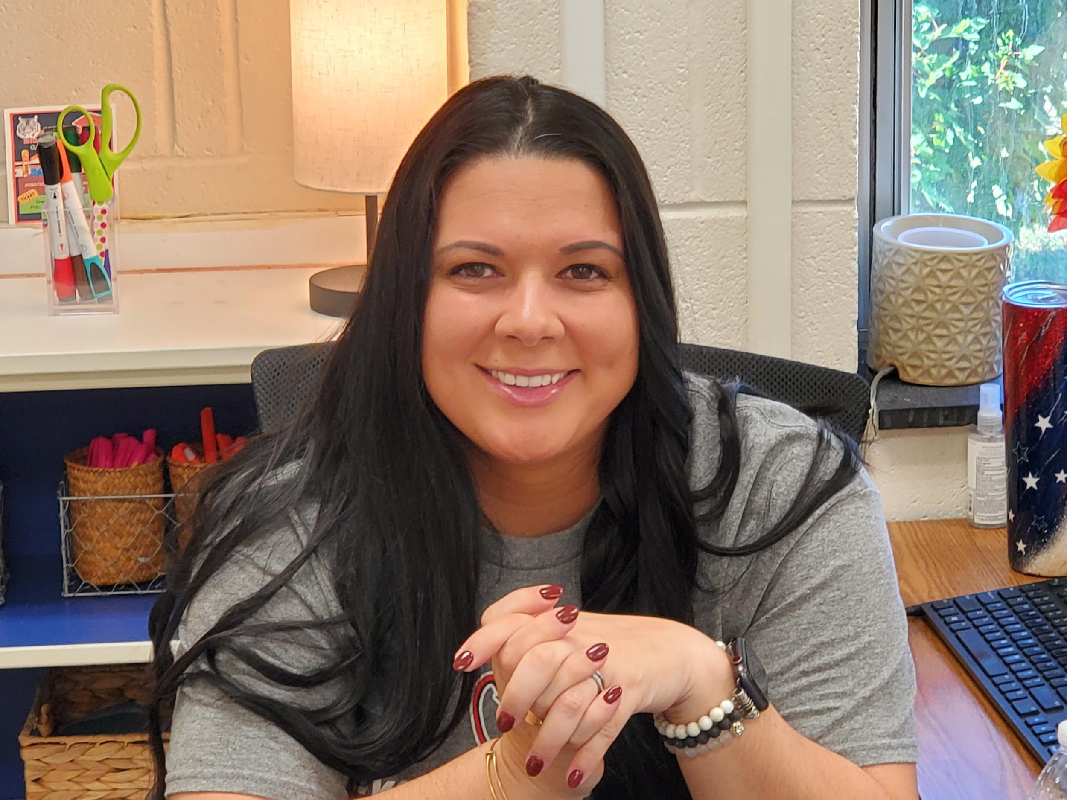
“The Right Work for the Right Reasons”
We Are
“Tiger Strong”

